Slide 1
UNIVERSITY OF PROFESSIONAL STUDIES,ACCRA
NEWS WRITING AND REPORTING
GROUP EIGHT PROJECT
PROJECT TITLE: EXPOSING THE DANGERS OF BREAST CANCER
NAME OF LECTURER: MR. ARCHIBALD NII SARBAH ADAMS
DATE:10TH DECEMBER,2025
GROUP MEMBERS
Klutse famous - 10325187
Quarshie Emmanuella - 10327063
Foresight Fadilatu Yaro - 10320990
Edem Sika Kumi-Dei- 10320999
Amonu Esther - 10321008
Addo Emmanuel Sowah - 10328386
Ankrah Dorcas - 10320982
Diana Boamah – 10318870
AKROFI EMMANUEL - 10330971

Slide 2
INTRODUCTION
Today, we're here to talk about something that affects millions of women worldwide, breast cancer. It's a disease that can touch any of us, whether directly or indirectly. Let's dive in and explore the risks, realities, and importance of early detection, and boost awareness.

Slide 3
PURPOSE AND SCOPE OF THE REPORT:OVERVIEW OF THE CHOSEN TOPIC & EVENT COVERED:
Overview of Exposing the Dangers of Breast Cancer
Topic: Exposing the Dangers of Breast Cancer
Purpose:
To raise awareness about the risks and impact of breast cancer, promote early detection, and support those affected.
Scope of the report
Discuss breast cancer statistics and trends in Ghana and globally
Explore risk factors, symptoms, and detection methods

Slide 4
PURPOSE AND SCOPE OF THE REPORT:OVERVIEW OF THE CHOSEN TOPIC & EVENT COVERED
Highlight treatment options and support resources
Emphasize the importance of early detection and screening
Events Covered:
Interviews with breast cancer survivors and healthcare professionals
WHAT IS BREAST CANCER?
Breast cancer is a disease where cells in the breast grow in an uncontrolled way. Normally, your body’s cells grow, divide, and die in an orderly pattern. But when some cells start growing too fast and don’t stop when they should, they can form a lump (called a tumor).

Slide 5
MAIN CAUSES,SYMPTOMS AND HOW TO REDUCE RISK OF BREAST CANCER
Breast cancer happens when cells in the breast grow and divide abnormally. The exact cause isn't always clear, but things like family history, aging, unhealthy lifestyle habits (poor diet, lack of exercise, or alcohol use), and hormonal factors (like starting menstruation early or not breastfeeding) can increase risk. Having a risk factor doesn't mean you'll definitely get breast cancer – being aware helps you take preventive steps early.
How can women reduce their risk of developing breast cancer?
Eat well (more fruits,veggies,less processed food)
Exercise regularly: Even 30 minutes a day makes a difference.
Avoid smoking and limit alcohol

Slide 6
MAIN CAUSES,SYMPTOMS AND HOW TO REDUCE RISK OF BREAST CANCER
Do monthly breast self-exams and go for regular check-ups/screenings.
Breastfeeding also helps reduce risk.
If you have a family history, discuss it with your doctor early so you can be monitored closely.

Slide 7
MAIN CAUSES,SYMPTOMS AND HOW TO REDUCE RISK OF BREAST CANCER
What are the symptoms of Breast Cancer ?
A lump or swelling in the breast or underarm.
Changes in breast shape or size.
Skin dimpling, redness, or scaling.
Nipple changes - pain, discharge, or pulling inwards.
If you notice anything unusual, don't panic - get checked right away. Early action can save your life.

Slide 8
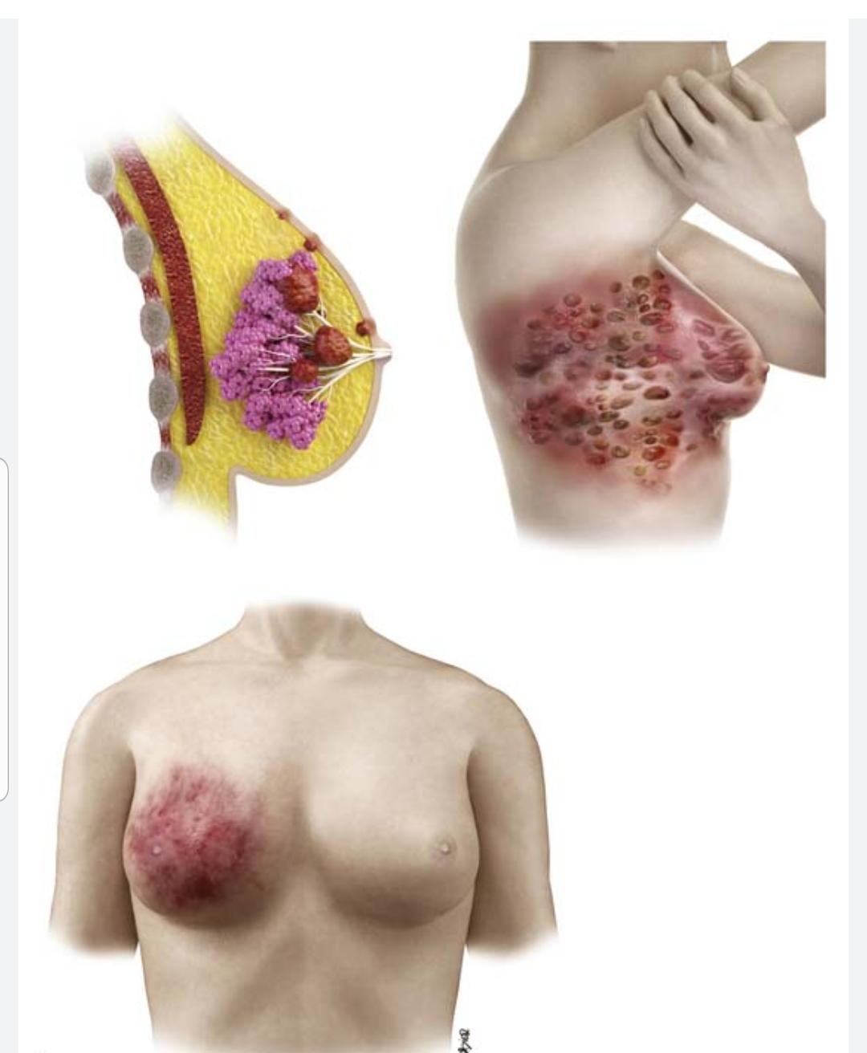
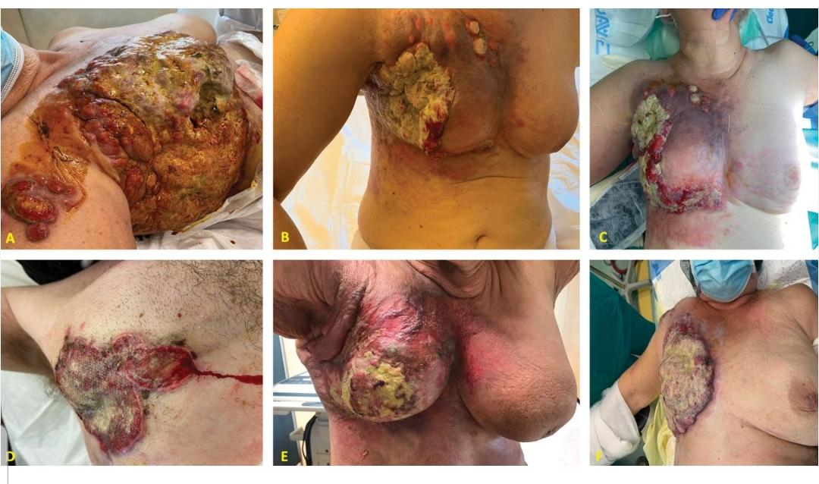

Slide 9
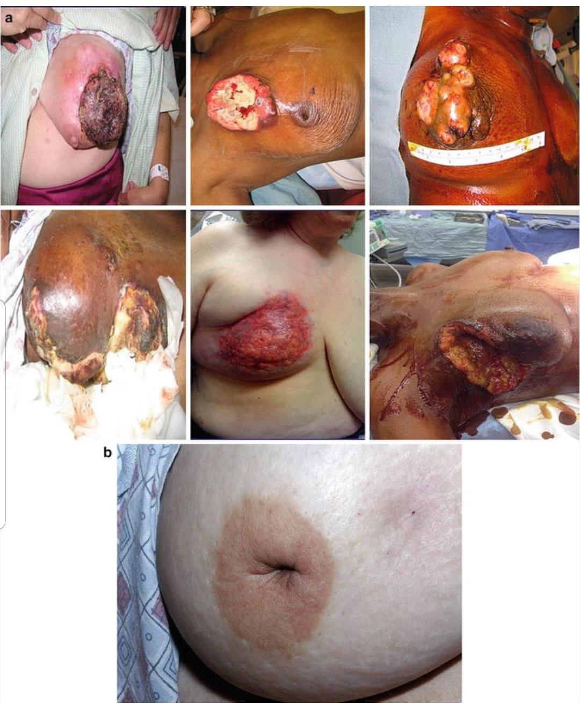
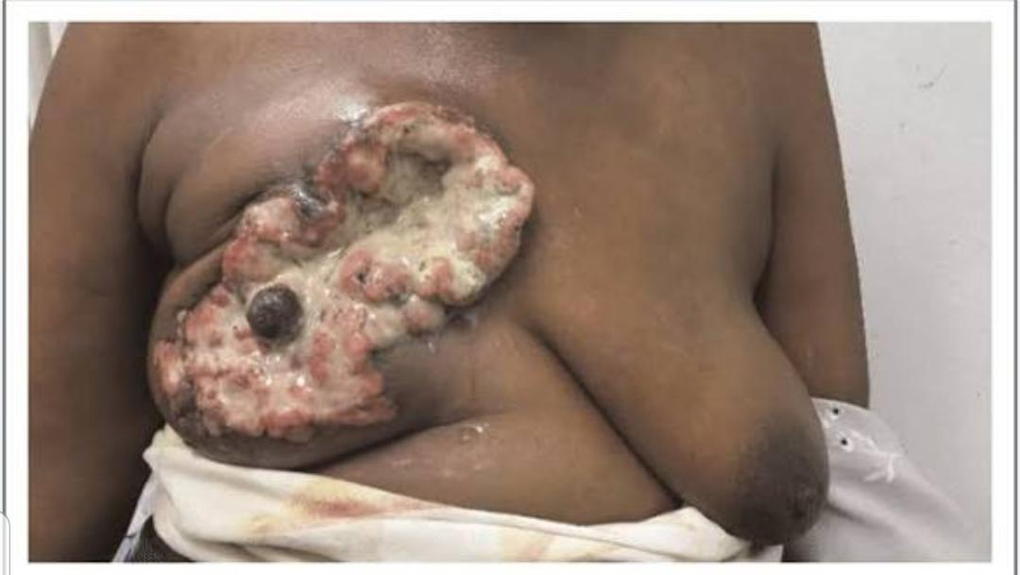

Slide 10
PROJECT DESCRIPTION
So, the story was about exposing the dangers of breast cancer which literally highlighted above some key considerations needed to take in, our rationale for selecting the topic "Exposing the Dangers of Breast Cancer is to
Encourage early detection and screening
Promote understanding of risk factors and symptoms
Support those affected by the disease
Contribute to reducing death rates
Let's have a look at our target audience:
Women and men in Ghana, particularly those aged 20-50
Individuals with a family history of breast cancer
Students
Community leaders and organizations

Slide 11
PROJECT DESCRIPTION
Our relevance of this targeted audience Is that;
1.Breast cancer affects many families in Ghana
2.Early detection and screening can improve survival rates
3.Awareness and education can reduce stigma and promote support
4.Empowering individuals and communities to take action
Our research and gathering of this information is done through interview with a healthcare professional

Slide 12
PROJECT DESCRIPTION
The team produced this news item by
Finding treatment options
Conducting interviews with experts and survivors.
Recording voiceovers or conducting live interviews

Slide 13
ALLOCATION OF ROLES
Famous Klutse – Presenter
Quarshie Emmanuella -Writer
Ankara Dorcas -Researcher
Addo Emmanuel Sowah – Editor
Boamah Diana – Writer
Franklina Adu – Organizer
Amonu Esther – Researcher
Foresight Fadilatu Yaro -Interviewer
Edem Sika Kumi-Del -Editor

